Slide 1
NLH update 03/31

Slide 2
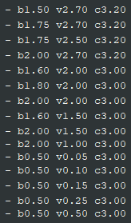
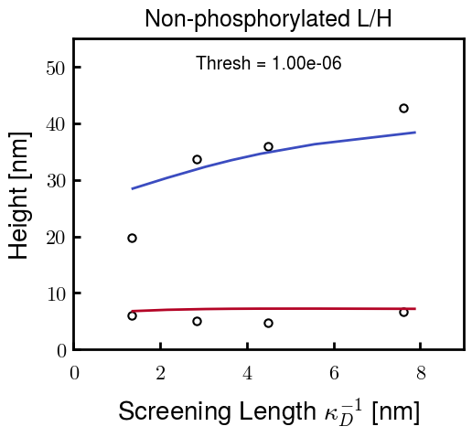


Original approach—Pure NFL/NFH
Choose parameters for NFL and NFH independently
NFL Possibilities
NFH Possibilities
For example,
b: Kuhn length
v: Monomer volume
c: Flory Huggins parameter for
most hydrophobic residues

Slide 3
Original approach—Blended NFL/NFH

Slide 4
New approach—maintain similar NFL and NFH volume

Slide 5
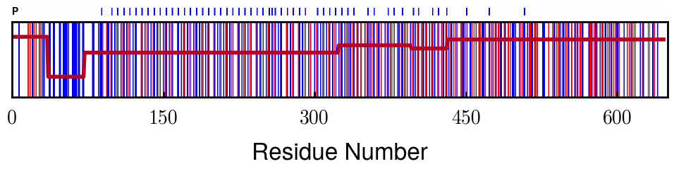
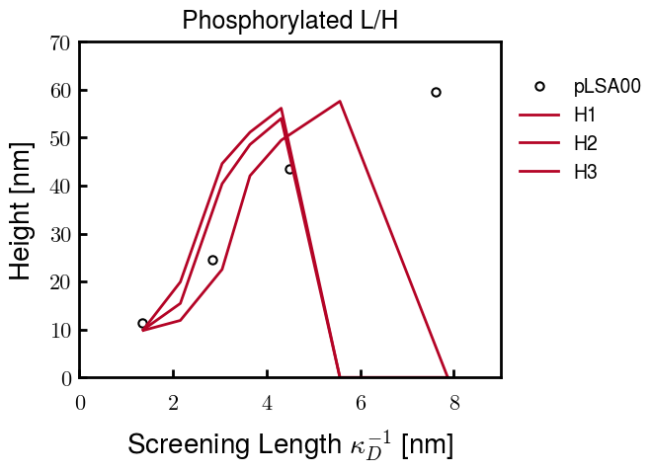
Phosphorylated NFH Progress
phosph. = - 1.5 e
Currently running one more to get a close fit; if not, the current best one should be close enough
Quick note: the points that go to zero just didn’t converge. The point at 6 nm takes a really long time to converge, so I will probably proceed with only calculating from 1 to 6 nm.
In the future, if needed, I can go to 8 nm (1.6 mM)

